Slide 1
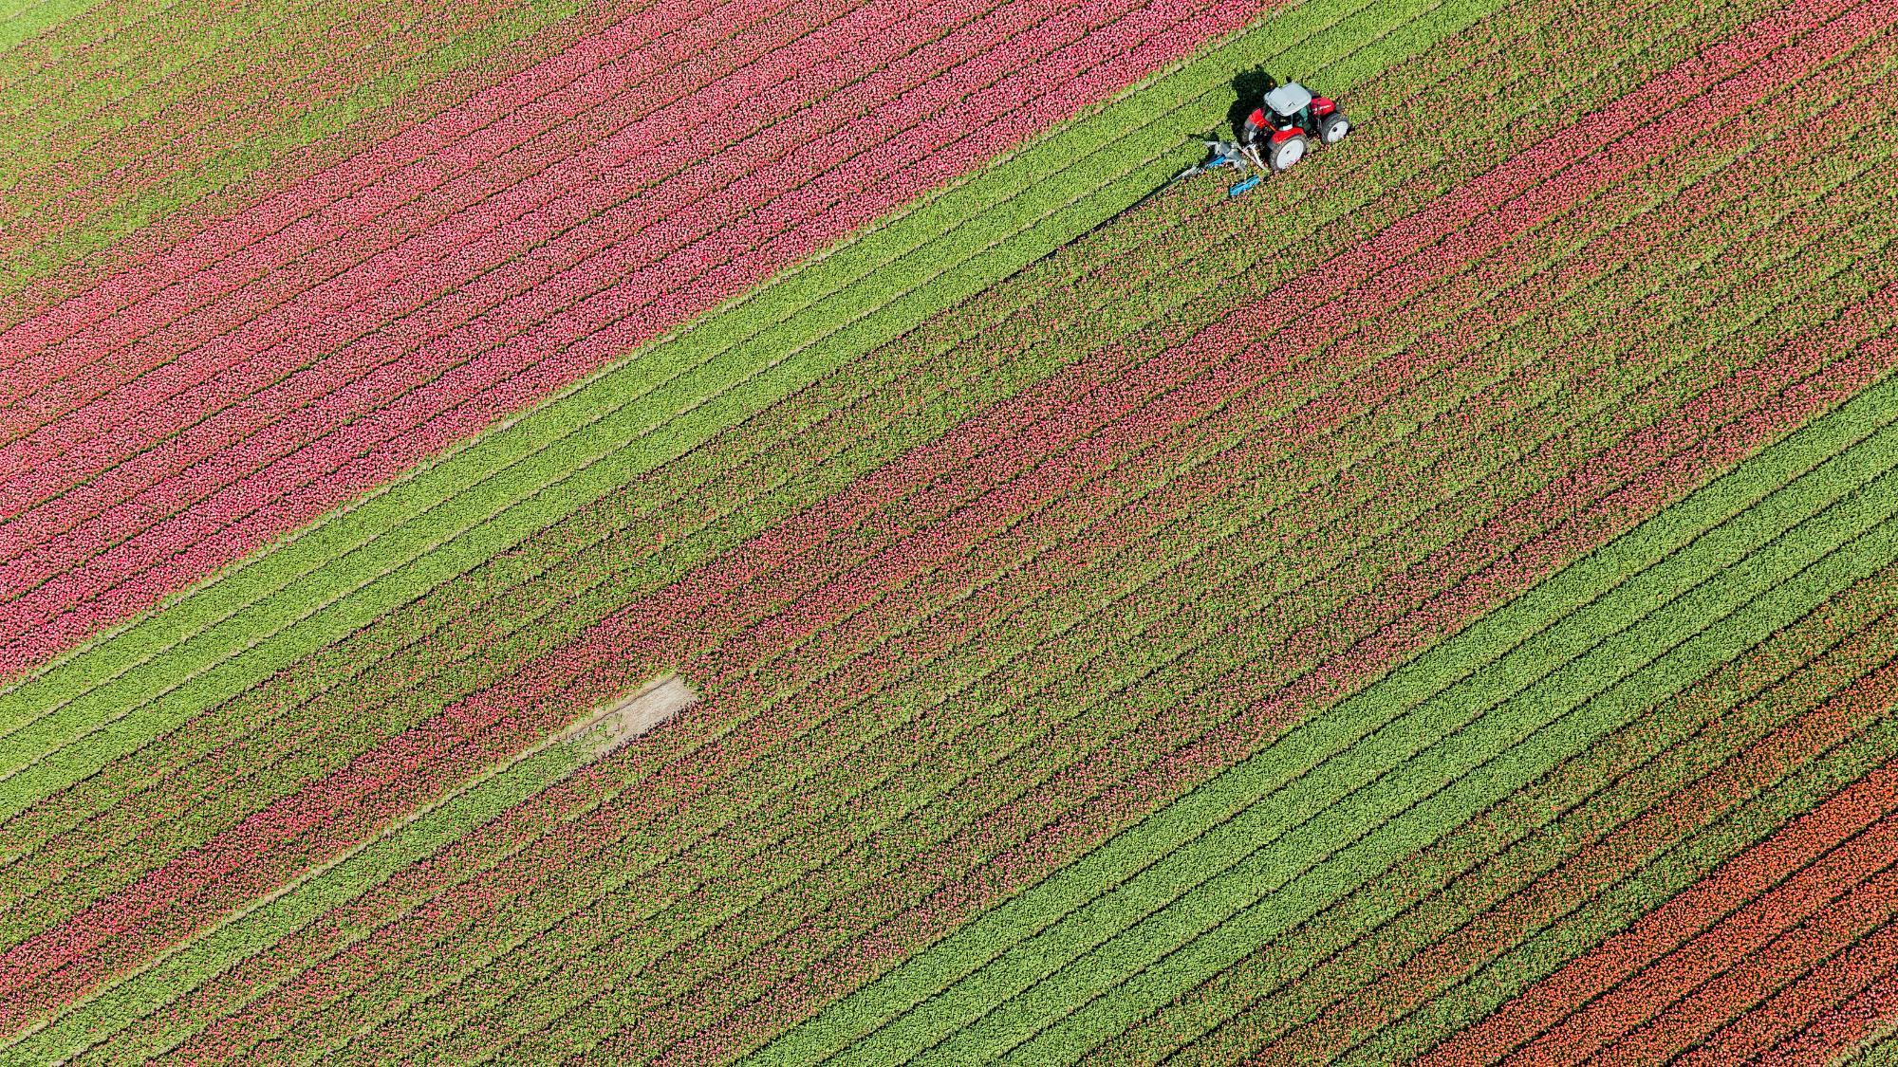
Agricultural idle time and armed conflict
Matthew DiGiuseppe, Roos Haer and Babak RezaeeDaryakenari
https://dataverse.harvard.edu/dataset.xhtml?persistentId=doi:10.7910/DVN/8XOFBS
Notes:
Definition of Idle Time:
Agricultural idle time refers to periods when labor demand for agricultural activities is low, freeing up individuals to engage in other pursuits, including political conflicts.

Slide 2


Research Question:
The study aims to investigate the relationship between agricultural idle time and armed conflict in African countries.
Theoretical Hypothesis:
Higher levels of agricultural idle time will be positively associated with the likelihood of observing armed conflict events.
Notes:
The study is grounded in the concept of opportunity costs, which suggests that individuals with low pay-offs for productive work are more likely to engage in predatory behaviour, such as rebellion or conflict. The central hypothesis is that agricultural idle time, representing periods when labour demand for agriculture is low, reduces the opportunity costs for individuals to participate in political conflict. Therefore, the study hypothesizes that higher levels of agricultural idle time will be positively associated with the likelihood of observing armed conflict events.
Overall, the study seeks to contribute to the understanding of the economic drivers of political conflict by examining the role of agricultural labour dynamics, particularly idle time, as a potential determinant of conflict onset.

Slide 3

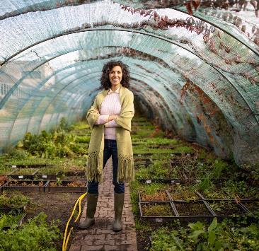
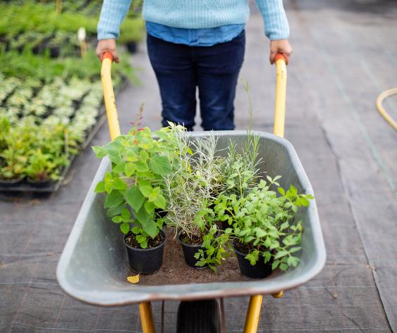
Abstract (extract)
Policymakers and scholars have long proposed that willingness to participate in armed conflict is influenced by citizens’ income-earning opportunities. Testing this opportunity cost mechanism has led to mixed results. One reason for this might be the fact that current proxies can also serve as indicators to test grievance-based theories. In this study, we construct a more suitable measure. We use crop calendars and crop location data to build an index of agricultural idle time for first administration units on the African continent from 1990 to 2017. We test the explanatory power of this measure by examining its relationship with armed conflict. Our results show that agricultural idle time increases the probability of observing armed conflict by more than 20 percent.
Notes:
Opportunity Costs vs. Grievances:
Scholars debate whether individuals are more likely to engage in rebellion or predatory behavior due to low opportunity costs or because of grievances.
Opportunity costs refer to the benefits that could have been gained from choosing an alternative course of action, such as engaging in productive work.
Grievances encompass feelings of injustice, dissatisfaction, or perceived inequality within society.
Central Claim:
The central claim of examining opportunity costs is that individuals with low pay-offs for productive work are more likely to engage in predatory behavior, like rebellion, compared to those with higher pay-offs.
In essence, individuals with limited opportunities or low abilities may resort to rebellion as a means of addressing their economic hardships.
Challenges in Finding Evidence:
Despite the straightforward idea, finding solid evidence to support the role of low opportunity costs in motivating political conflict has been challenging.
Studies have produced mixed results: some find evidence supporting the opportunity mechanism, while others find no effect or even an opposite effect.

Slide 4
Summary of Datasets Used:
Social Conflict Analysis Database (SCAD)
Armed Conflict Location Event Dataset (ACLED)
Uppsala Conflict Data Program-Georeferenced Event Dataset (UCDP-GED)
Crop Location Data
Crop Calendar Charts
Notes:
Social Conflict Analysis Database (SCAD):
Records monthly violent events initiated by non-state groups against governmental authorities or oppositional groups.
Used to create a binary variable indicating the onset of violent political conflict.
Armed Conflict Location Event Dataset (ACLED):
Covers various political dissident events beyond battles, including remote violence.
Provides data on the onset of conflict events.
Uppsala Conflict Data Program-Georeferenced Event Dataset (UCDP-GED):
Defines conflict events as incidents involving armed force by organized actors against other organized actors or civilians, resulting in at least one direct death.
Records state-based and non-state conflict events.
Crop Location Data:
Collected around the year 2000.
Obtained from EarthStat dataset, which combines national, state, and county-level census statistics to estimate crop coverage globally.
Used to identify locally grown crops and their coverage share in each administrative unit-month.
Crop Calendar Charts:
Obtained from the United States Department of Agriculture’s International Production Assessment Division.
Provide information on planting, growing, maintaining, and harvesting seasons for various crops in different countries.
Used to determine months when each crop requires labor.

Slide 5
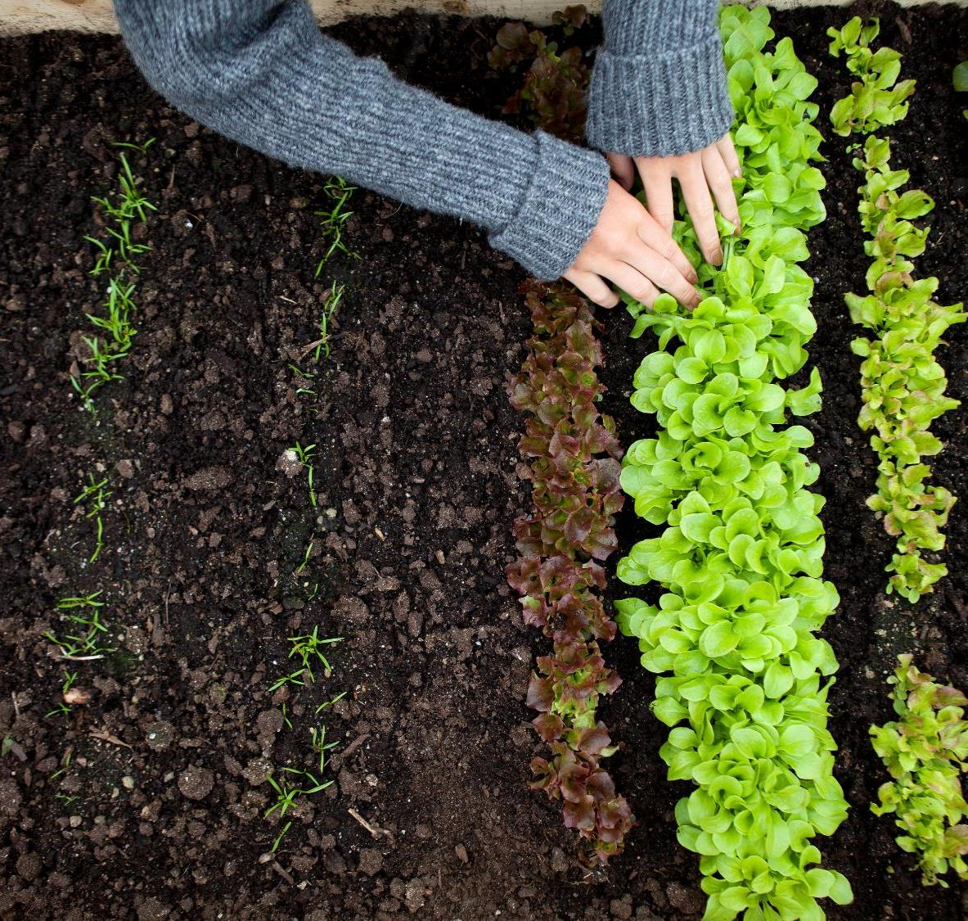
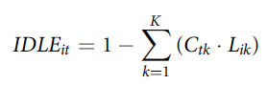
Model
IDLEit = Index related to agricultural idle time
Ctk = represents the coverage share of each crop (k) (as a percentage of total crop area) in each month t
Lik = is a binary indicator of whether that crop (k) requires labour in a particular month within a particular administrative district i.
Notes:
“In our analysis, we focus on 17 crops that represent most of the agricultural production in Africa: barley, buckwheat, cereals, cotton, groundnut, maize, millet, mixed grain, oats, potato, rapeseed, rice, rye, sorghum, soybean, sunflower, and wheat. We then aggregate the coverage dataset and the crop calendar to the first administrative unit with the following index:”

Slide 6

Chart

Slide 7


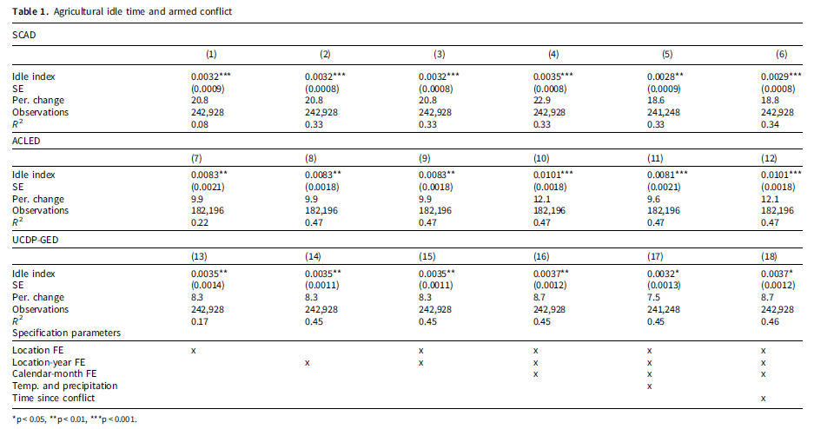
Notes:
Dependent Variables: Three different measures of conflict are used: SCAD (Social Conflict Analysis Database), ACLED (Armed Conflict Location Event Dataset), and UCDP-GED (Uppsala Conflict Data Program-Georeferenced Event Dataset). Each measure captures different aspects of political violence.
Independent Variable: The agricultural idle index is the main independent variable of interest. The coefficients indicate the change in the probability of conflict occurrence associated with a one-unit increase in the idle index.
Results Summary:
The coefficients for the idle index are statistically significant across all specifications and outcome variables, indicated by the p-values (p < 0.01 or *p < 0.001).
The magnitude of the coefficients suggests that an increase in the agricultural idle index is associated with a significant increase in the probability of conflict occurrence. For example, in the SCAD model, a one-unit increase in the idle index is associated with a 20.8% increase in the probability of conflict.
The models' explanatory power, indicated by the R-squared values, varies across specifications but generally falls within the range of 0.08 to 0.47, suggesting moderate to substantial explanatory power.
Specification Parameters:
Location fixed effects, location-year fixed effects, and calendar-month fixed effects are included in all models to control for location-specific, temporal, and seasonal variations.
Additional control variables such as temperature and precipitation, as well as the time since the last conflict event, are also included in the analysis.
Overall, the results consistently show that agricultural idle time is positively associated with the likelihood of conflict occurrence across different measures of conflict, providing support for the hypothesis that variations in agricultural labor demand influence political conflict dynamics.

Slide 8
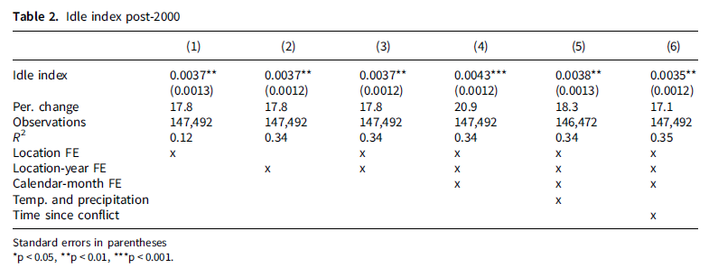
Notes:
Results Summary:
The coefficients for the idle index remain statistically significant across all specifications and outcome variables, denoted by the significance levels (p < 0.01 or *p < 0.001).
Consistent with the findings from Table 1, the coefficients indicate a positive association between agricultural idle time and the likelihood of conflict occurrence. For instance, in the SCAD model, a one-unit increase in the idle index is associated with a 17.8% increase in the probability of conflict.
The explanatory power of the models, as indicated by the R-squared values, remains moderate to substantial, ranging from 0.12 to 0.35.
Specification Parameters:
Similar to Table 1, location fixed effects, location-year fixed effects, and calendar-month fixed effects are included in all models to control for various sources of variation.
Additional control variables such as temperature and precipitation, as well as the time since the last conflict event, are also accounted for in the analysis.
Overall, the results from Table 2 reaffirm the positive association between agricultural idle time and conflict occurrence, even when focusing specifically on the post-2000 period. This provides further robustness to the findings and underscores the importance of considering agricultural labour dynamics in understanding political conflict dynamics.

Slide 9

The way to get started is to quit talking and begin doing.
Walt Disney

Slide 10




Team
Name
Name
Name
Name
Title
Title
Title
Title

Slide 11
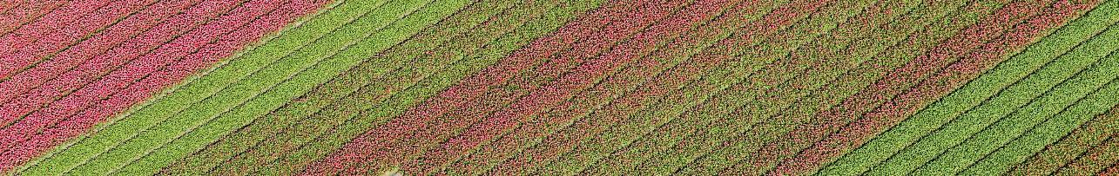
Timeline
Title
Title
If you can’t see the Notes pane or it is completely minimised, click Notes on the task bar across the bottom of the PowerPoint window.
To display Presenter view, in Slide Show view, on the control bar at the bottom left select the three dots, and then Show Presenter View.
Title
During your presentation, the speaker notes are visible on your monitor, but aren't visible to the audience.
To start a presentation, go to the Slide Show tab, and select From Beginning.
The Notes pane is a box that appears below each slide. Tap it to add notes.

Slide 12
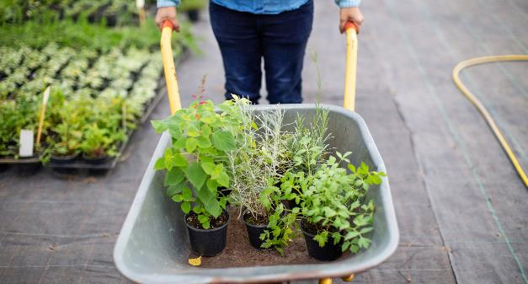
Two Content
Subtitle
Subtitle
Add text, images, art, and videos.
Add transitions, animations, and motion.
Save to OneDrive, to get to your presentations from your computer, tablet, or phone.
Open the Design Ideas pane for instant slide makeovers.
When we have design ideas, we’ll show them to you right there.

Slide 13
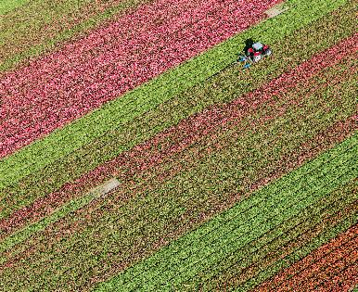
Three Content
Subtitle
Subtitle
Subtitle
Add text, images, art, and videos.
Add transitions, animations, and motion.
Save to OneDrive, to get to your presentations from your computer, tablet, or phone.
Open the Design Ideas pane for instant slide makeovers.
When we have design ideas, we’ll show them to you right there.
This PowerPoint theme uses its own unique set of colours, fonts and effects to create the overall look and feel of these slides.
PowerPoint has tons of themes to give your presentation just the right personality.

Slide 14

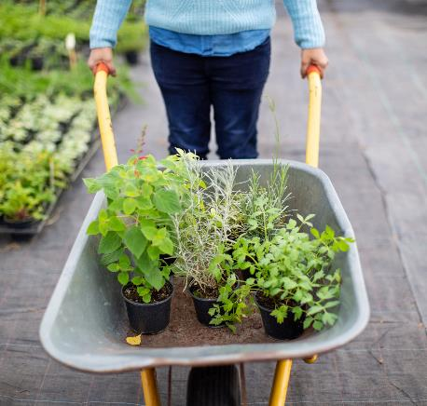
Summary
With PowerPoint, you can create presentations and share your work with others, wherever they are. Type the text you want here to get started. You can also add images, art, and videos on this template. Save to OneDrive and access your presentations from your computer, tablet, or phone.

Slide 15


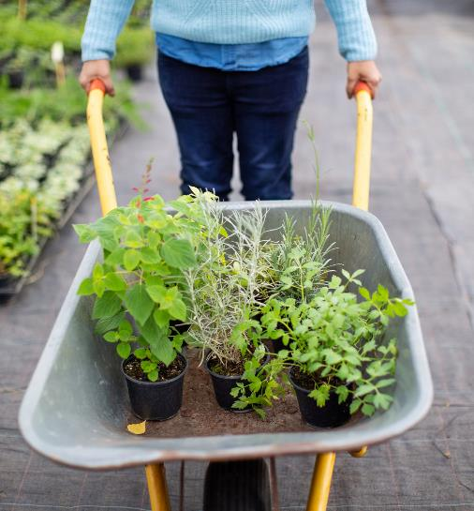

Thank You
Presenter Name
Email
Website

